Slide 1
WATER QUALITY ANALYSIS
PRESENTED BY :
SHIVA MAMILLA
CSE
DATA SCIENCE

Slide 2

INTRODUCTION
Water quality analysis is a critical aspect of environmental monitoring and public health. By leveraging data analytics, we can enhance the accuracy, efficiency, and depth of insights derived from water quality data.
Integrating data analytics into water quality analysis significantly enhances the ability to monitor, understand, and manage water resources effectively.

Slide 3
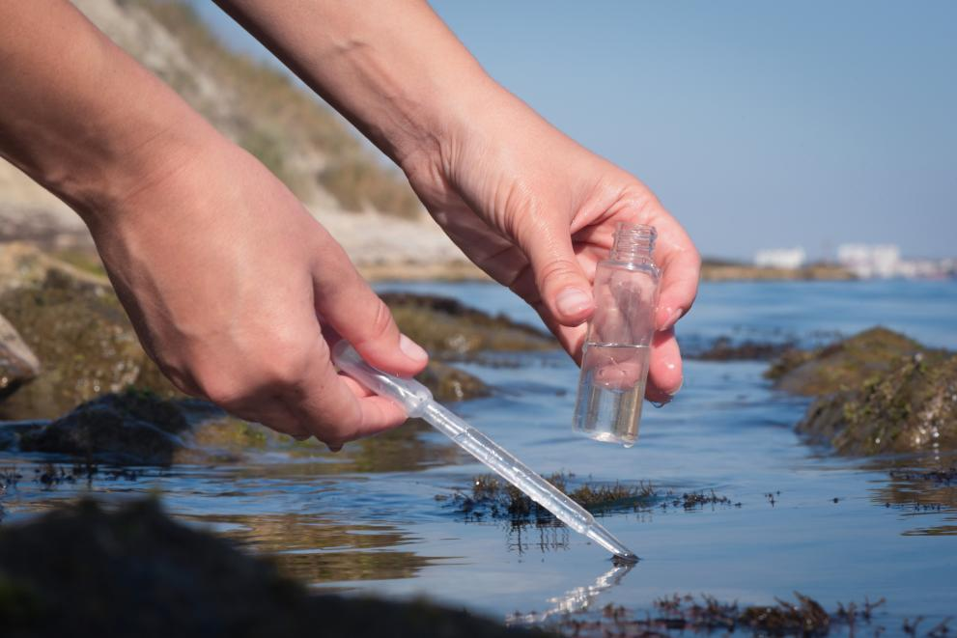
METHODOLOGY
Analyzing water quality through data analytics involves several key steps, from data collection to interpretation. Here's a comprehensive methodology are:
1. Data Collection: Determine sources of water quality data, such as sensors, manual sampling, government databases, and research institutions.
2. Data Preprocessing: Remove or correct erroneous data, handle missing values, and filter outliers3.DATA PREPROCESSING
3. Exploratory Data Analysis (EDA) : Generate summary statistics (mean, median, standard deviation, etc.) for each parameter.
4. Advanced Analytics and Modeling
Correlation Analysis: Assess the relationships between different water quality parameters. Regression Analysis: Develop regression models to predict water quality based on influencing factors.

Slide 4
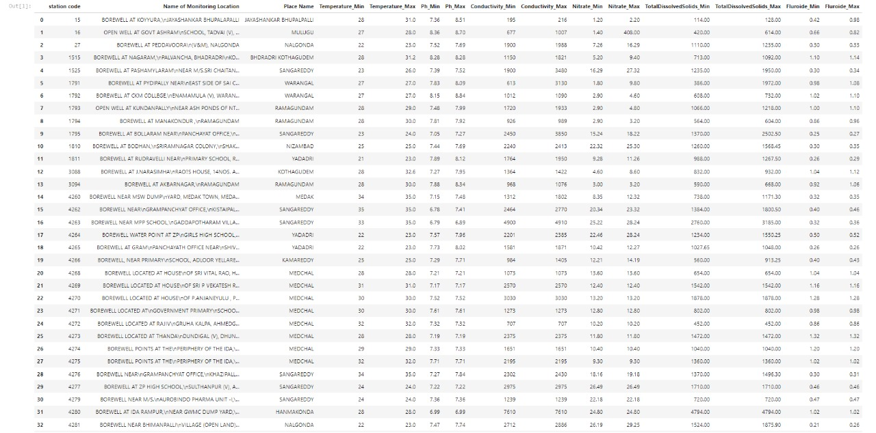
DATA SET

Slide 5
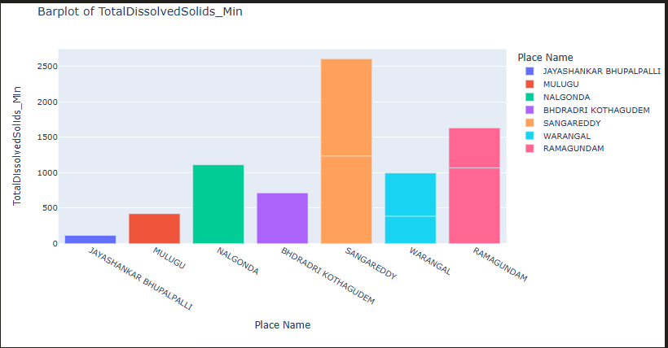
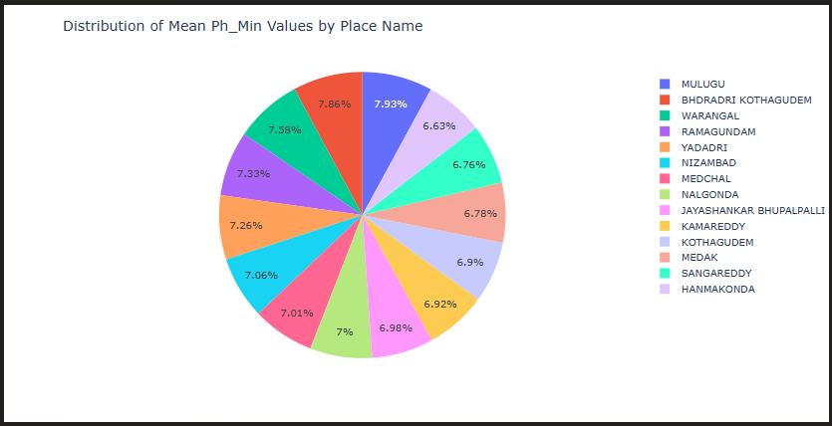
RESULTS

Slide 6
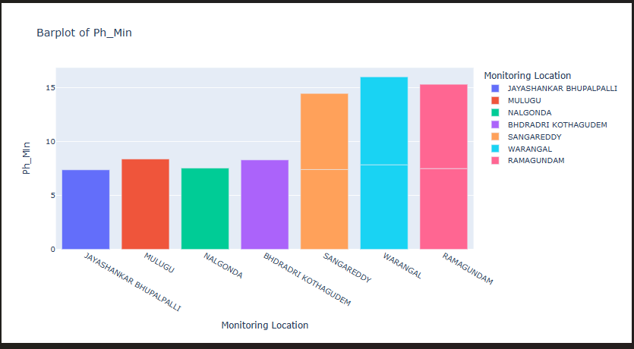
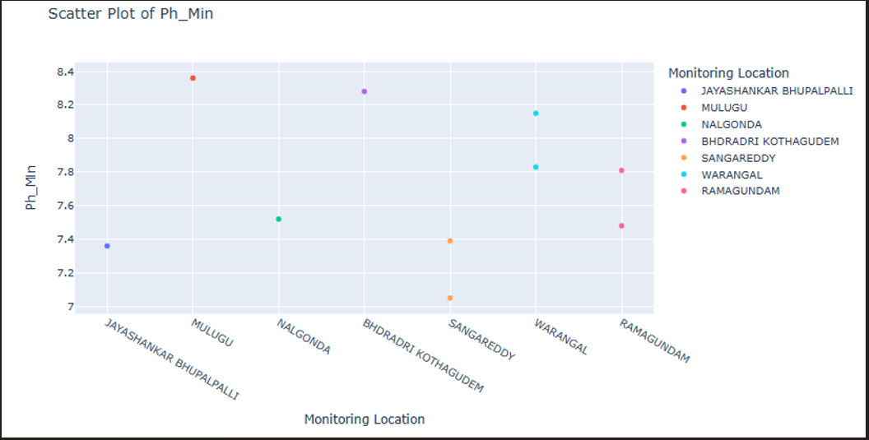

Slide 7
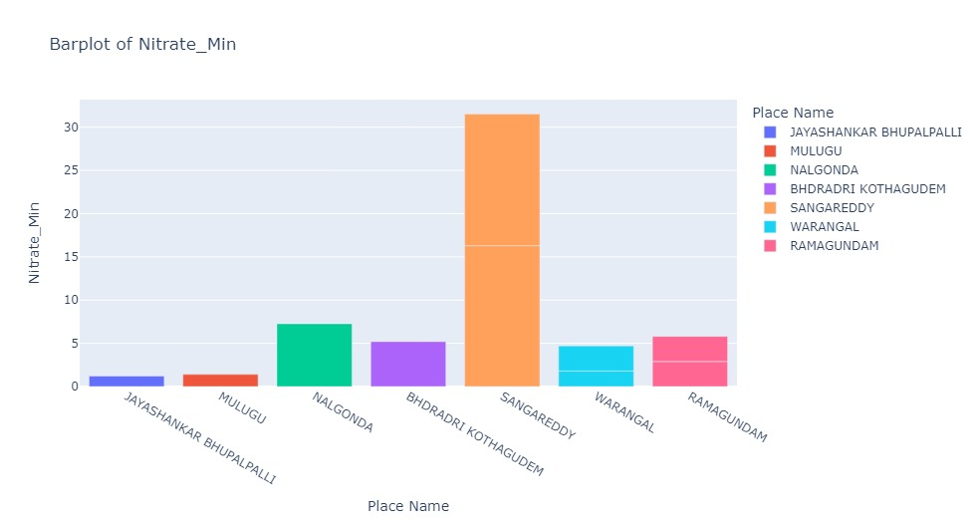
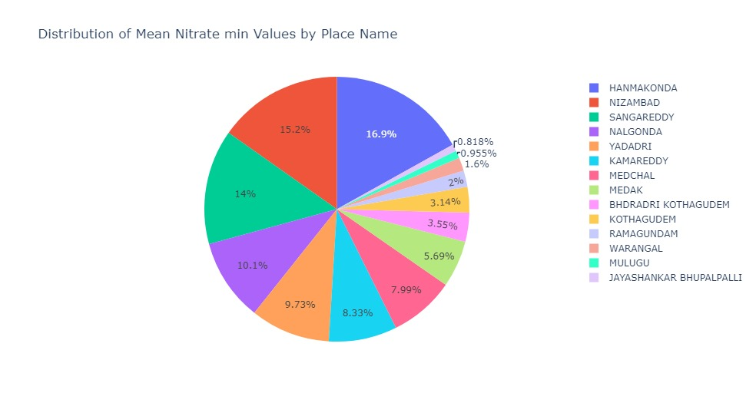

Slide 8
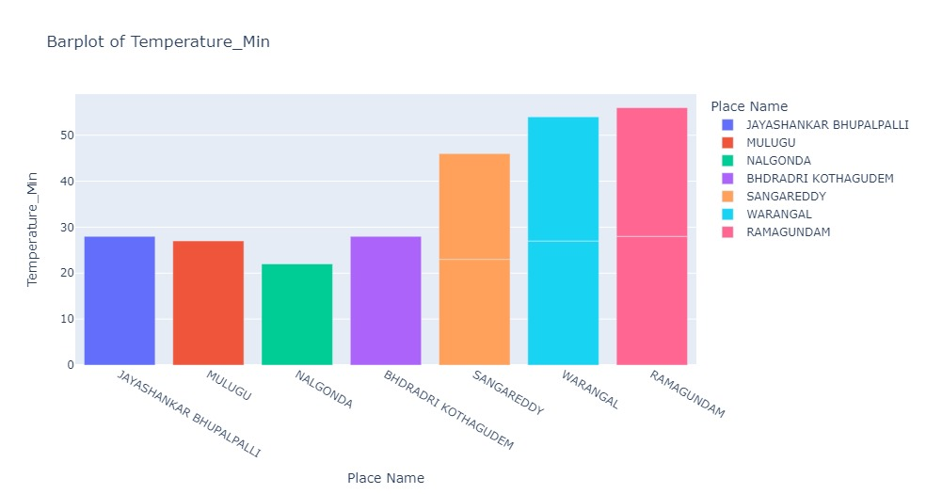
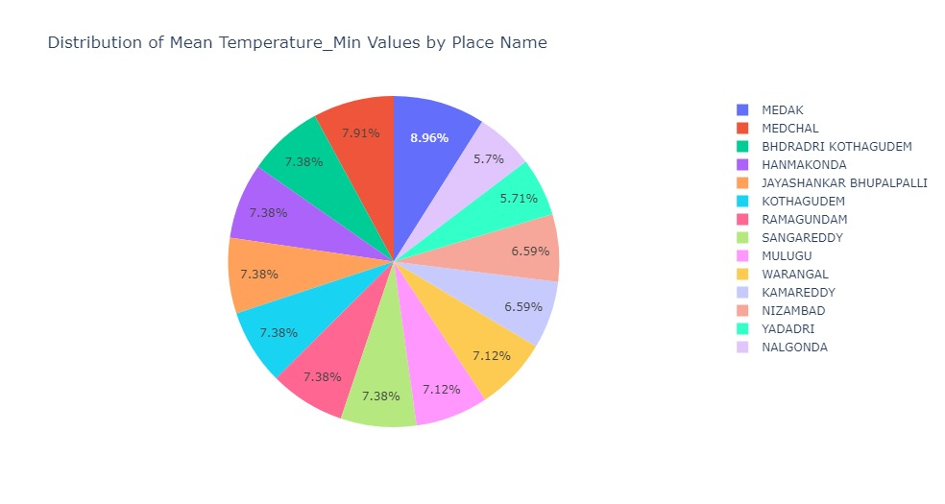

Slide 9
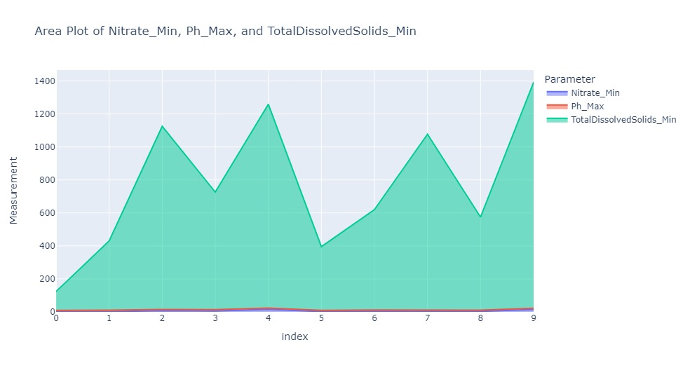
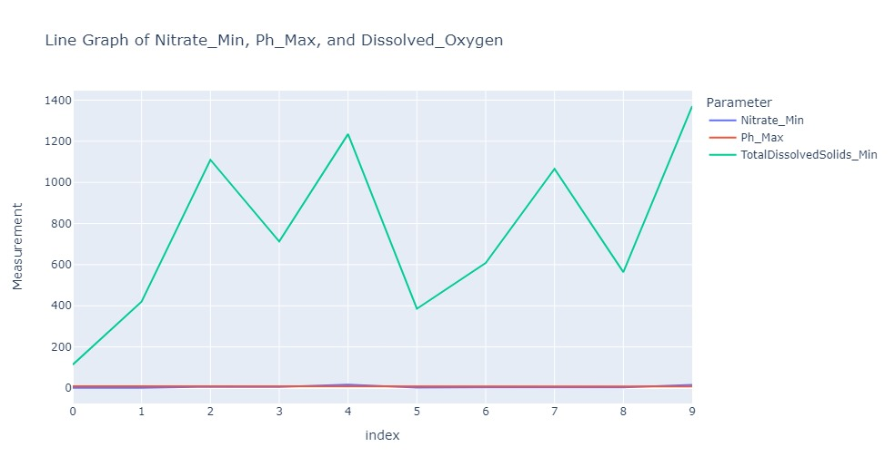

Slide 10
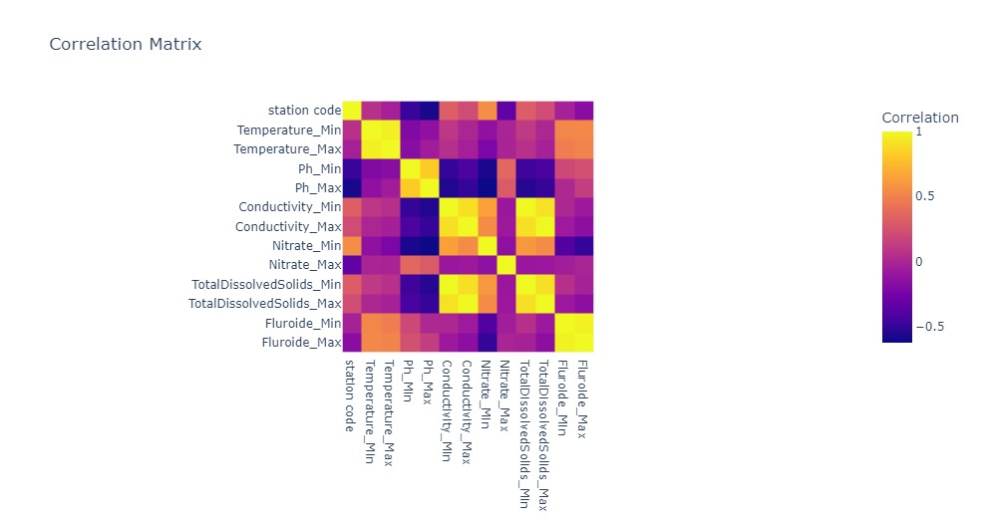

Slide 11
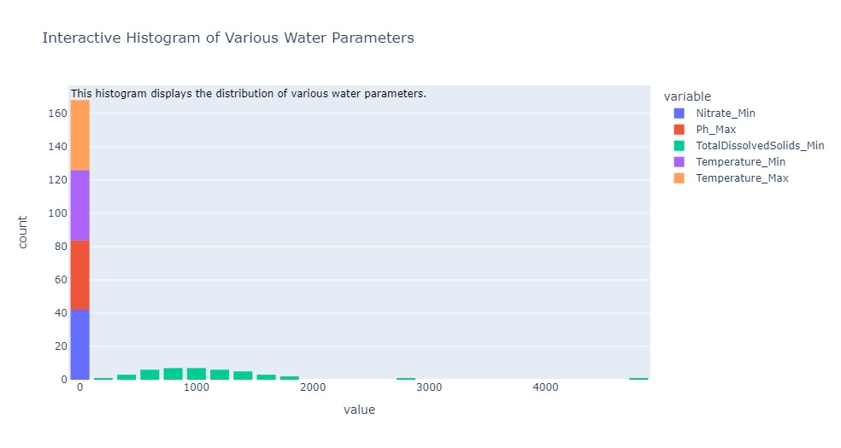

Slide 12
RESULTS
Our web site Link:
https://waterqualityanalysis5.wordpress.com

Slide 13
CONCLUSION
The water quality analysis project has provided valuable insights into the state of water resources in the studied region. By leveraging data analytics techniques, we were able to assess various parameters and their impact on overall water quality.
Identification of Key Pollutants:
The analysis highlighted significant pollutants affecting water quality, including nitrates, phosphates, heavy metals, and microbial contaminants. These findings align with known sources such as agricultural runoff, industrial discharge, and inadequate waste management.
Impact on Human Health and Ecosystems:Elevated levels of contaminants pose serious health risks, including waterborne diseases and long-term exposure effects. Ecosystems are also impacted, with noticeable declines in biodiversity in polluted water bodies.

Slide 14
REFERNCES
1.Chapman, D. (1996). Water Quality Assessments - A Guide to Use of Biota, Sediments and Water in Environmental Monitoring (2nd ed.). E&FN Spon, London, UK.
2.Sawyer, C. N., McCarty, P. L., & Parkin, G. F. (2003). Chemistry for Environmental Engineering and Science (5th ed.). McGraw-Hill Education.
3.World Health Organization (WHO). (2017). Guidelines for Drinking-water Quality (4th ed.). WHO. •
WHO's guidelines provide international standards for drinking water quality and the basis for establishing national regulations and standards.
4.Hach Company. (2020). Water Analysis Handbook (5th ed.). Hach Company. • A practical manual detailing various water analysis techniques and the use of Hach instruments for water quality testing.
Cosmetic products, https://www.kaggle.com/datasets/mssmartypants/water-quality

Slide 15


